Slide 1
Terminologies
Sungjoon Choi

Slide 2
Terminologies are Important

Slide 3
Input Data

Slide 4
Output / Class / Label
Cat
[1 0 0 0]
Dog
[0 1 0 0]
Cow
[0 0 1 0]
Horse
[0 0 0 1]

Slide 5

Training / Learning

Slide 6

Dataset
Training Data
Validation Data
(Cross-validation)
Test Data

Slide 7
Neuron

Slide 8
Basic Single Layer Network
1
2
W
4
Weight
0
+
ReLu
Input
b
Output
Bias

Slide 9
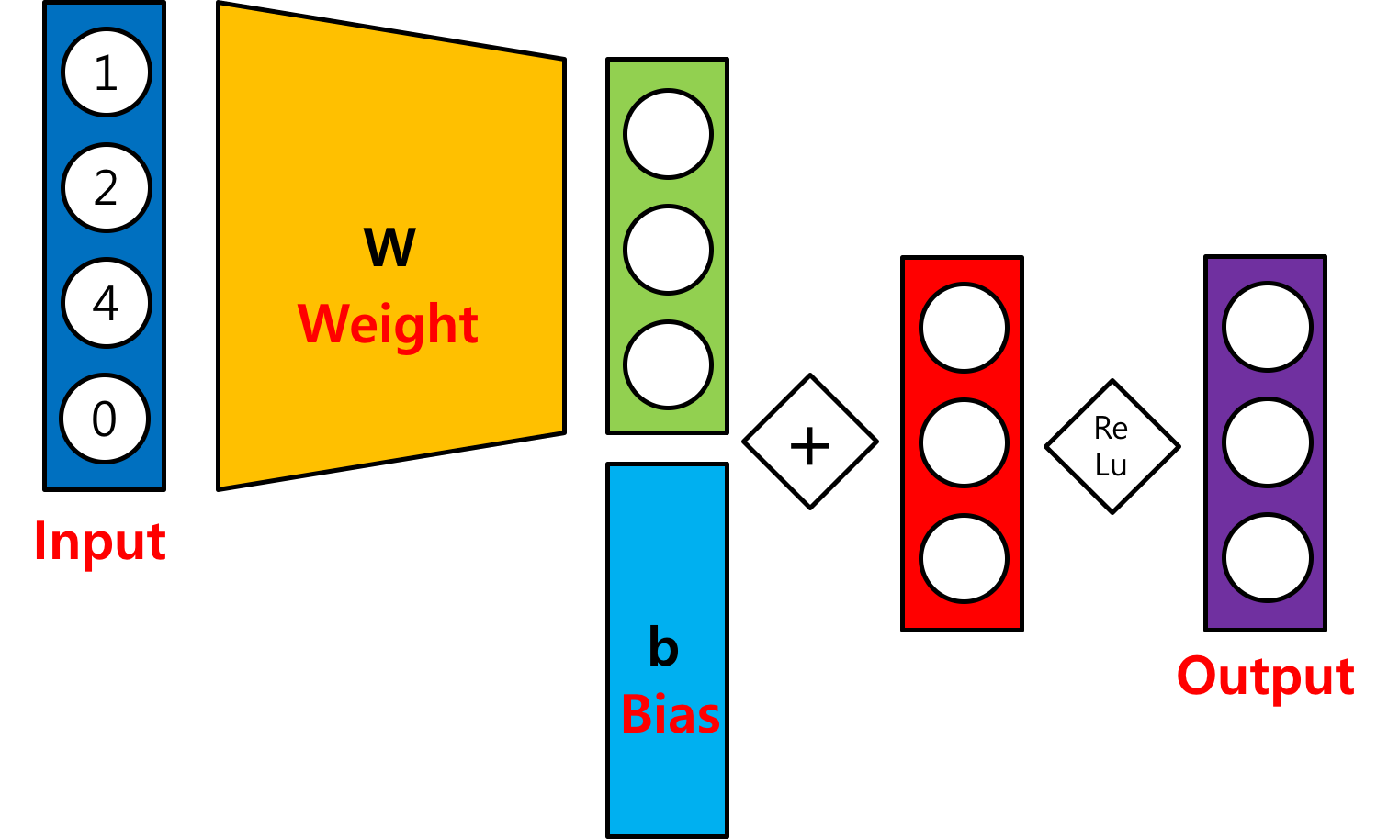
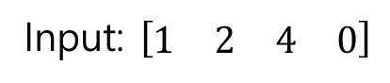
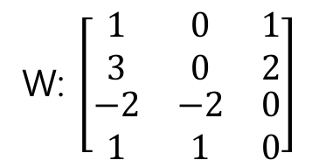
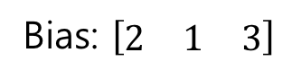
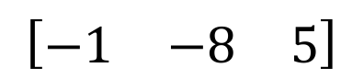
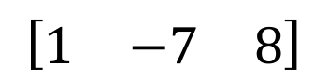
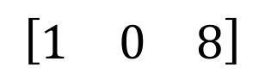
Basic Single Layer Network
Input: $\left[\begin{matrix}\begin{matrix}1 & 2\end{matrix} & \begin{matrix}4 & 0\end{matrix}\end{matrix}\right]$
W: $\left[\begin{matrix}\begin{matrix}\begin{matrix}1 \\ 3\end{matrix} \\ \begin{matrix}−2 \\ 1\end{matrix}\end{matrix} & \begin{matrix}\begin{matrix}0 \\ 0\end{matrix} \\ \begin{matrix}−2 \\ 1\end{matrix}\end{matrix} & \begin{matrix}\begin{matrix}1 \\ 2\end{matrix} \\ \begin{matrix}0 \\ 0\end{matrix}\end{matrix}\end{matrix}\right]$
Bias: $\left[\begin{matrix}2 & 1 & 3\end{matrix}\right]$
$$\left[\begin{matrix}−1 & −8 & 5\end{matrix}\right]$$
$$\left[\begin{matrix}1 & −7 & 8\end{matrix}\right]$$
$$\left[\begin{matrix}1 & 0 & 8\end{matrix}\right]$$

Slide 10
(Neural) Network

Slide 11
Artificial Neural Network
Input Layer
Hidden Layers
Output Layer

Slide 12
Multi-Layer Perceptron

Slide 13
Activation Function

Slide 14
Epoch / Batch size / Iteration
One epoch: one forward and backward pass of all training data
Batch size: the number of training examples in one forward and backward pass
One iteration: number of passes
If we have 55,000 training data, and the batch size is 1,000. Then, we need 55 iterations to complete 1 epoch.

Slide 15
MNIST (Mixed National Institute of Standards and Technology)

